Slide 1
Excel HR Attrition Dashboard
- PREPARED AND PRESENTED BY BAWYA JAI PRABHU

Slide 2
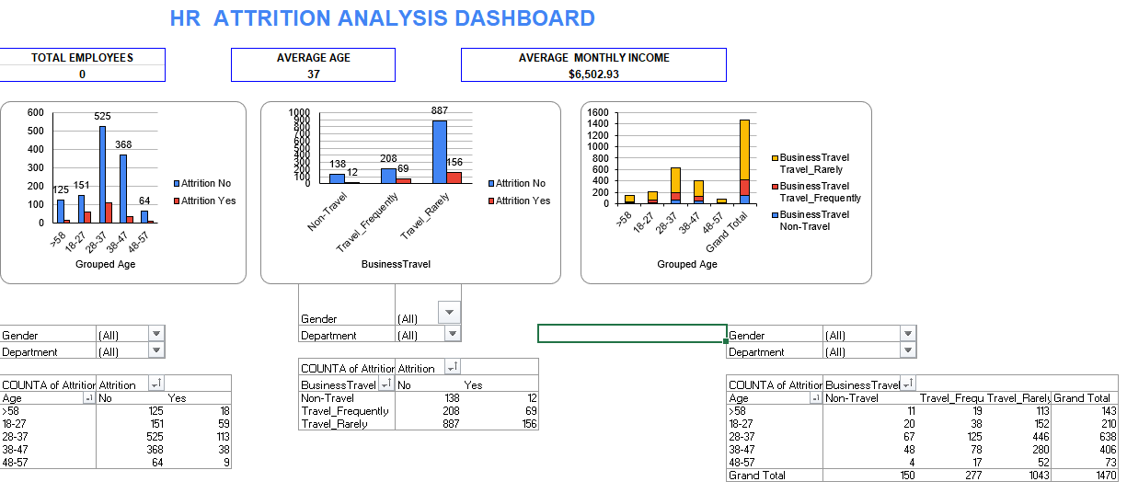
Business Problem

Slide 3
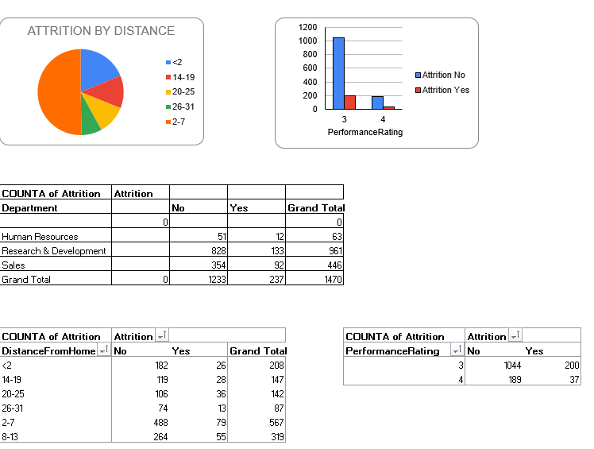
Business Problem

Slide 4
Insights uncovered from the report
Total number of 1470 employees. In that 237 employees are undergoes attrition process.
Majorly 28-37 aged employees are in attrition.
In this report most female employees are receiving less monthly income or salary compared to male employees
In the total 1470 employees almost 80% employees are rarely travelling in that people most are under 28-37 age employees.
In this report most of the male employees are in attrition.
Single i.e. who are Unmarried are the one is in attrition compared to married employees.
Performance Rating, who got 3 ratings and who are nearby to company are the employees are in attrition.

